Slide 1
Digital Image Processing EMOTION RECOGNITION USING FACIAL EXPRESSION
Professor:Dr. Geetha S
KEVIN SIMEON JOSHUA: 20MIS1088
PREM KUMAR: 20MIS1179
DEEPAN SAKARAVARTHI: 20MIS1160
HARISH S: 20MIS1045

Slide 2
OVERVIEW
Abstract
Motivation behind the topic
Literature survey
Design of the project
Modules
Methodology
Result
Conclusion

Slide 3
ABSTRACT
Expressions on the face are a vital mode of communication in humans as well as animals. Human behavior, psychological traits, are all easily studied using facial expressions. It is also widely used in medical treatments and therapies.
An emotion recognition system from facial expression is used for recognizing expressions from the facial images and classifying them into one of the six basic emotions.
Feature extraction and classification are the two main steps in an emotion recognition system.

Slide 4
MOTIVATION
Sentiment Analysis and Face Detection, individually have numerous use-cases in today’s world. We see object detection algorithms in public parking lots, traffic monitoring systems, etc. that take images of people driving vehicles to keep records. Sentiment Analysis is furthermore used in therapy where physical meetings of the therapist and their patient are not possible. The study of human cognition has also evolved medicines. On the technological front, virtual assistants, profile evaluation assistants, and automation bots are built to mimic the actions of humans and replace them with the hope of increasing accuracy and decreasing errors. It is therefore a very important part of the Artificial Intelligence inspired world we live in today.

Slide 5
LITERATURE SURVEY
Emotion recognition using facial expressions - Procedia Computer Science, Volume 108, 2017, Pages 1175-1184
In the article there are presented the results of recognition of seven emotional states (neutral, joy, sadness, surprise, anger, fear, disgust) based on facial expressions. Coefficients describing elements of facial expressions, registered for six subjects, were used as features. The features have been calculated for three-dimensional face model. The classification of features were performed using k-NN classifier and MLP neural network.

Slide 6
LITERATURE SURVEY
Emotion Recognition from Facial Expressions Using Frequency Domain Techniques- Suja P., Tripathi S., Deepthy J. (2014)
In this paper transform techniques such as Dual – Tree Complex Wavelet Transform (DT-CWT) and Gabor Wavelet Transform are considered for the formation of feature vectors along with Neural Network (NN) and K-Nearest Neighbor (KNN) as the Classifiers. These methods are combined in different possible combinations with the two aforesaid approaches and the databases to explore their efficiency. From this we have chosen the suitable machine learning algorithm for emotion detection according to our convenience

Slide 7
DESIGN OF THE PRODUCT
1. Function 1- This function is responsible for extracting the individual image frames from a video and then analyze those independently.
2. Each frame analyzed by this function is stored as a separate image by the algorithm in the root directory folder where the code is running. Also, this function later creates a replica of the original video by placing a box around the face and showing live emotions within the video.

Slide 8
DESIGN OF THE PRODUCT
3. We then create a Pandas Data Frame from these analyzed values and plot this data frame using matplotlib. In this plot, we can see every emotion plotted against time.
4. We can further analyze this data frame by taking individual emotion values that were recognized by the model and finding which sentiment was dominant across the entire video.

Slide 9
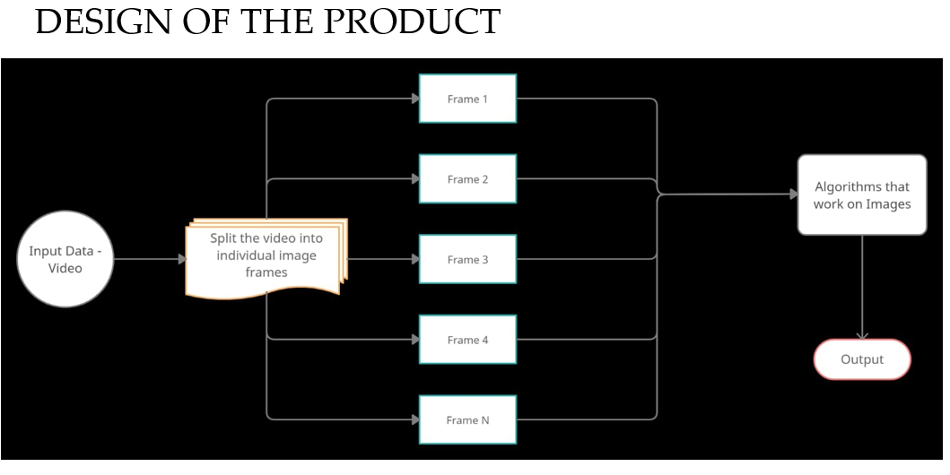

Slide 10
Modules
1. Function to extract individual frames
2. Emotion recognition algorithm integration with the separate images
3. Pandas data frame module
4. Analyze different emotion values and find dominant emotion

Slide 11
METHODOLOGY
Import the required python libraries like numpy, seaborn, matplotlib, tensorflow. We have imported different modules from keras which is a wrapping on tensorflow.
after getting the dataset, using os library we get the train folder path , n we will generate training and testing (validation) batches so that our model could be trained and evaluated/validated on the test data.
Then, we have initialized the CNN model by using sequential() function. After that we have created the first four layer of the neural network which are Convolution Layer.

Slide 12
For train the model and evaluating the results, First of all we have set the number of epochs where One Epoch is when an entire dataset is passed forward and backward through the neural network
As the number of epochs increases, more number of times the weight are changed in the neural network and the curve goes from underfitting to optimal to overfitting curve.
we have then imported model_from_json function which helps us to import the model from a json file.
After reading the json file and using the model_from_json function to load the model, we are loading the weights into the model. After this in the Class we have defined a method named predict_emotion which gives the prediction of the image. First it uses .predict method to give prediction after that we are using the numpy argmax to get a integer number b/w 0–6 representing the corresponding emotion in the list.

Slide 13
RESULT
There are 2 windows that will appear as output
One will show the webcam feed on which it will detect the face and tell the emotion on the face.
The other window shows the probability of the emotions that are portrayed on the face from the webcam feed.

Slide 14


Slide 15
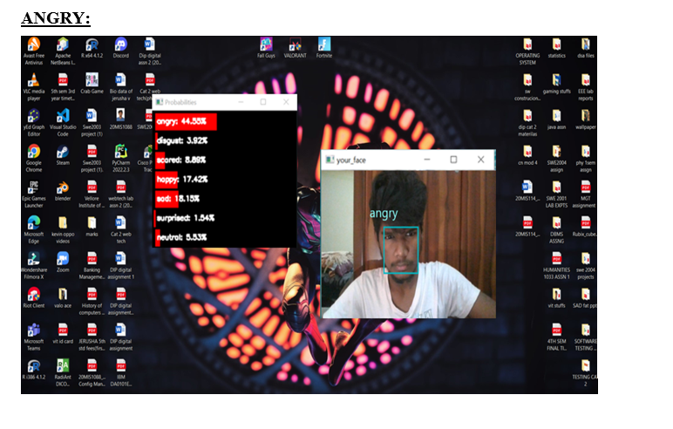

Slide 16
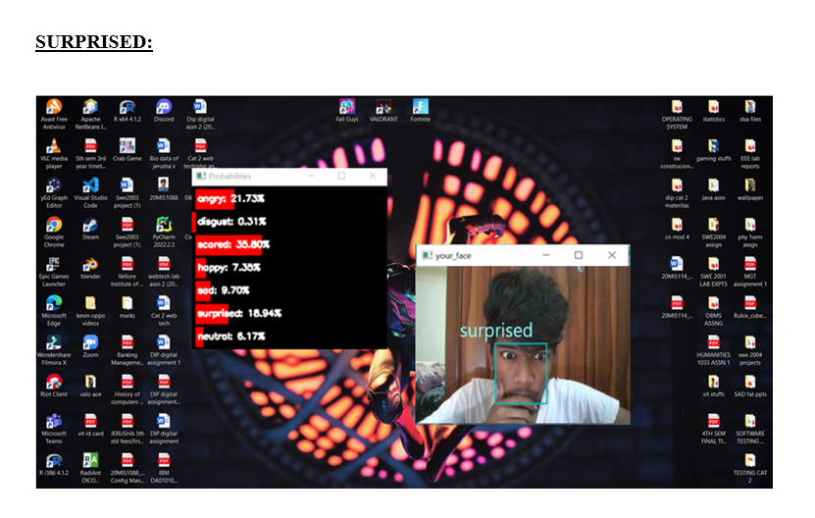

Slide 17
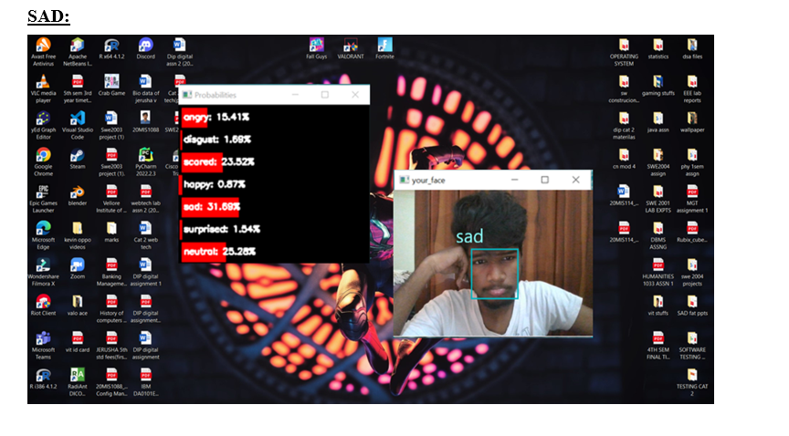

Slide 18
CONCLUSION
We can use the power of Artificial Intelligence to work on Cognitive Science and deal with human faces, this space is generally referred to as Computer Vision. We were able to extract emotions out of photos and videos of human faces. The accuracy of the emotion recognition from facial detection can be upto 60-65% from our methods. Because of its applications, there are constantly many machine learning models arising, aiming to gain the maximum accuracy when implemented in real-time applications. Through our project we learnt the importance of emotion recognition concepts in upcoming years.

Slide 19
THANK YOU

